Slide 1
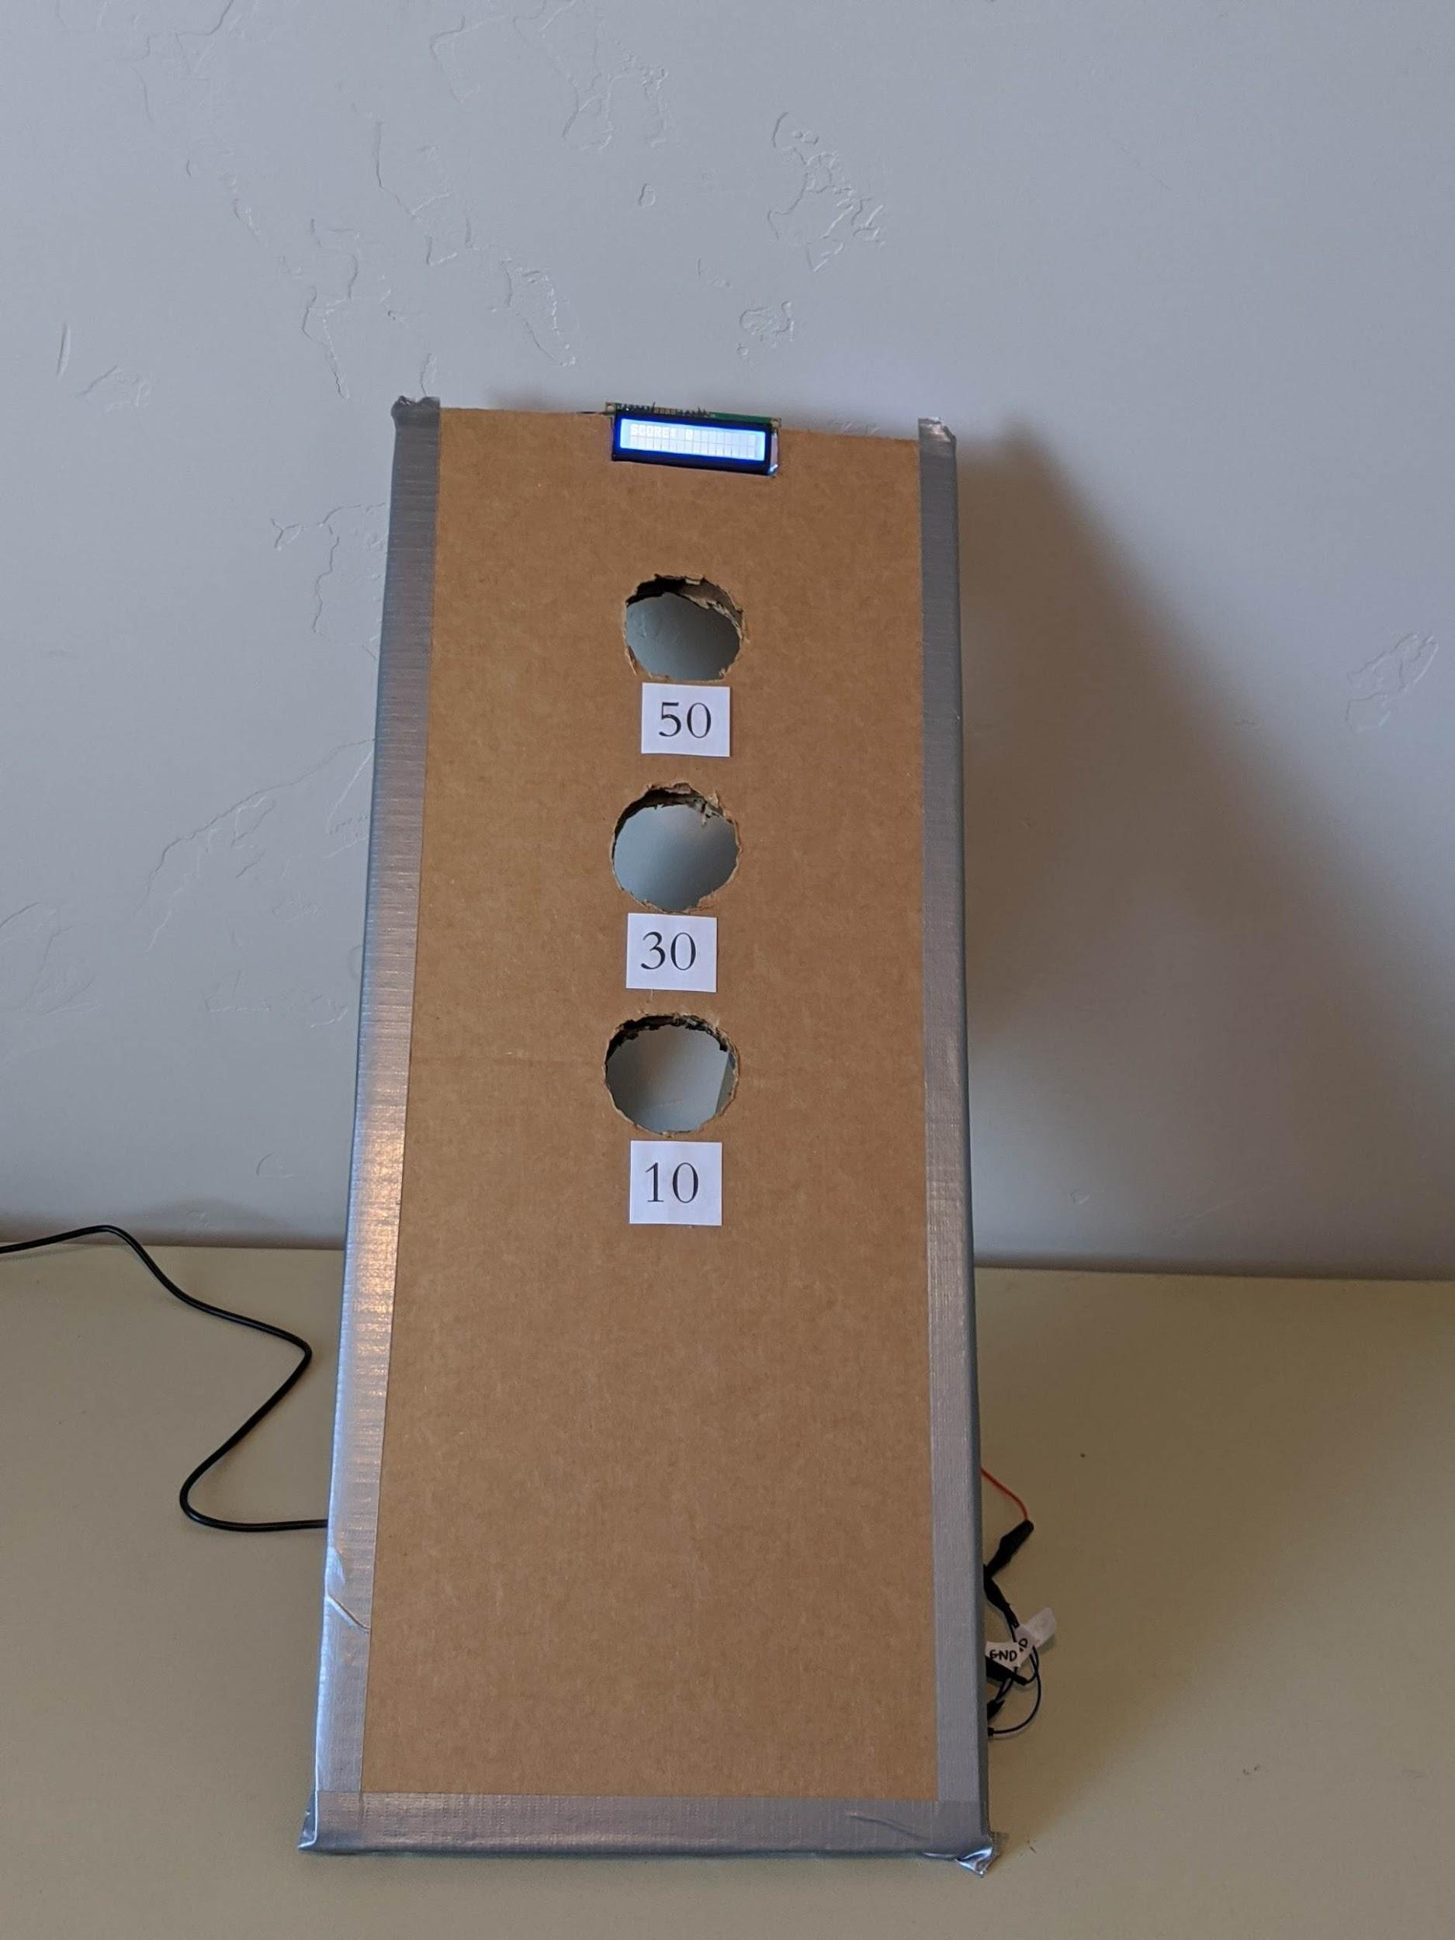
Bean Bag Toss Game
Becket, Ben, Dale

Slide 2
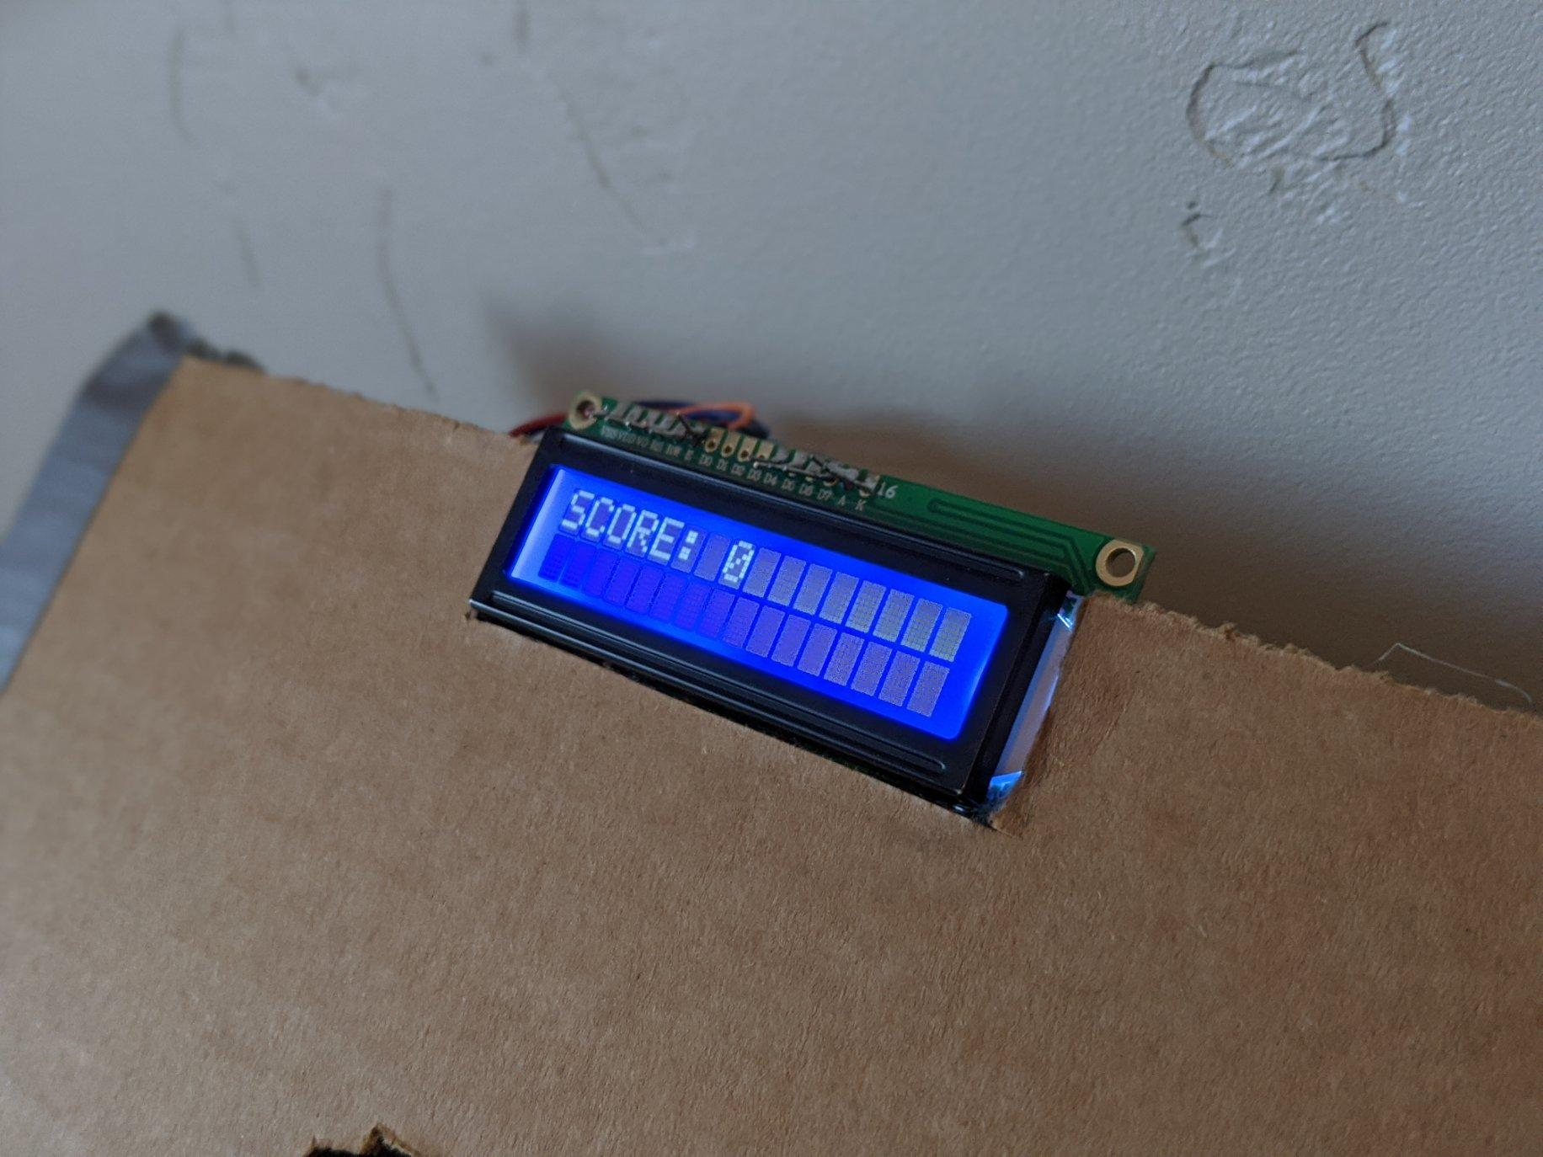
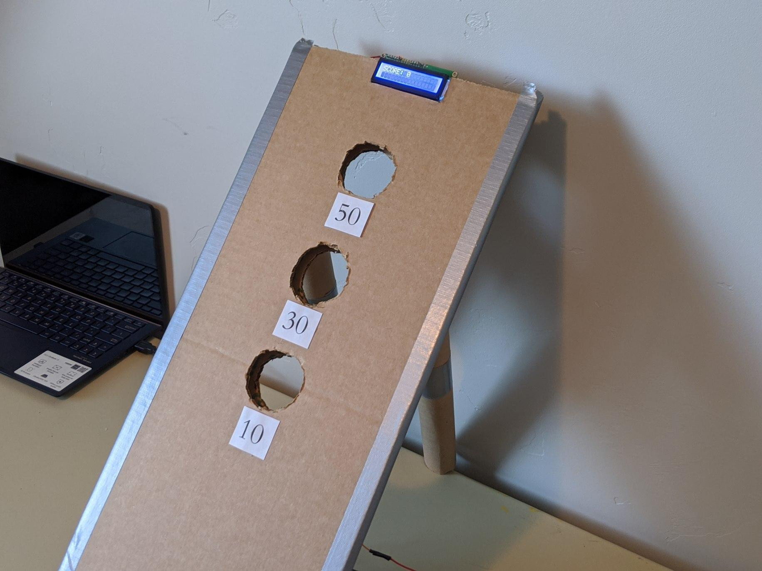
Bean Bag Toss Game
Photoelectric Sensors at each hole
MSP432 keeps track of score
LCD screen displays score

Slide 3
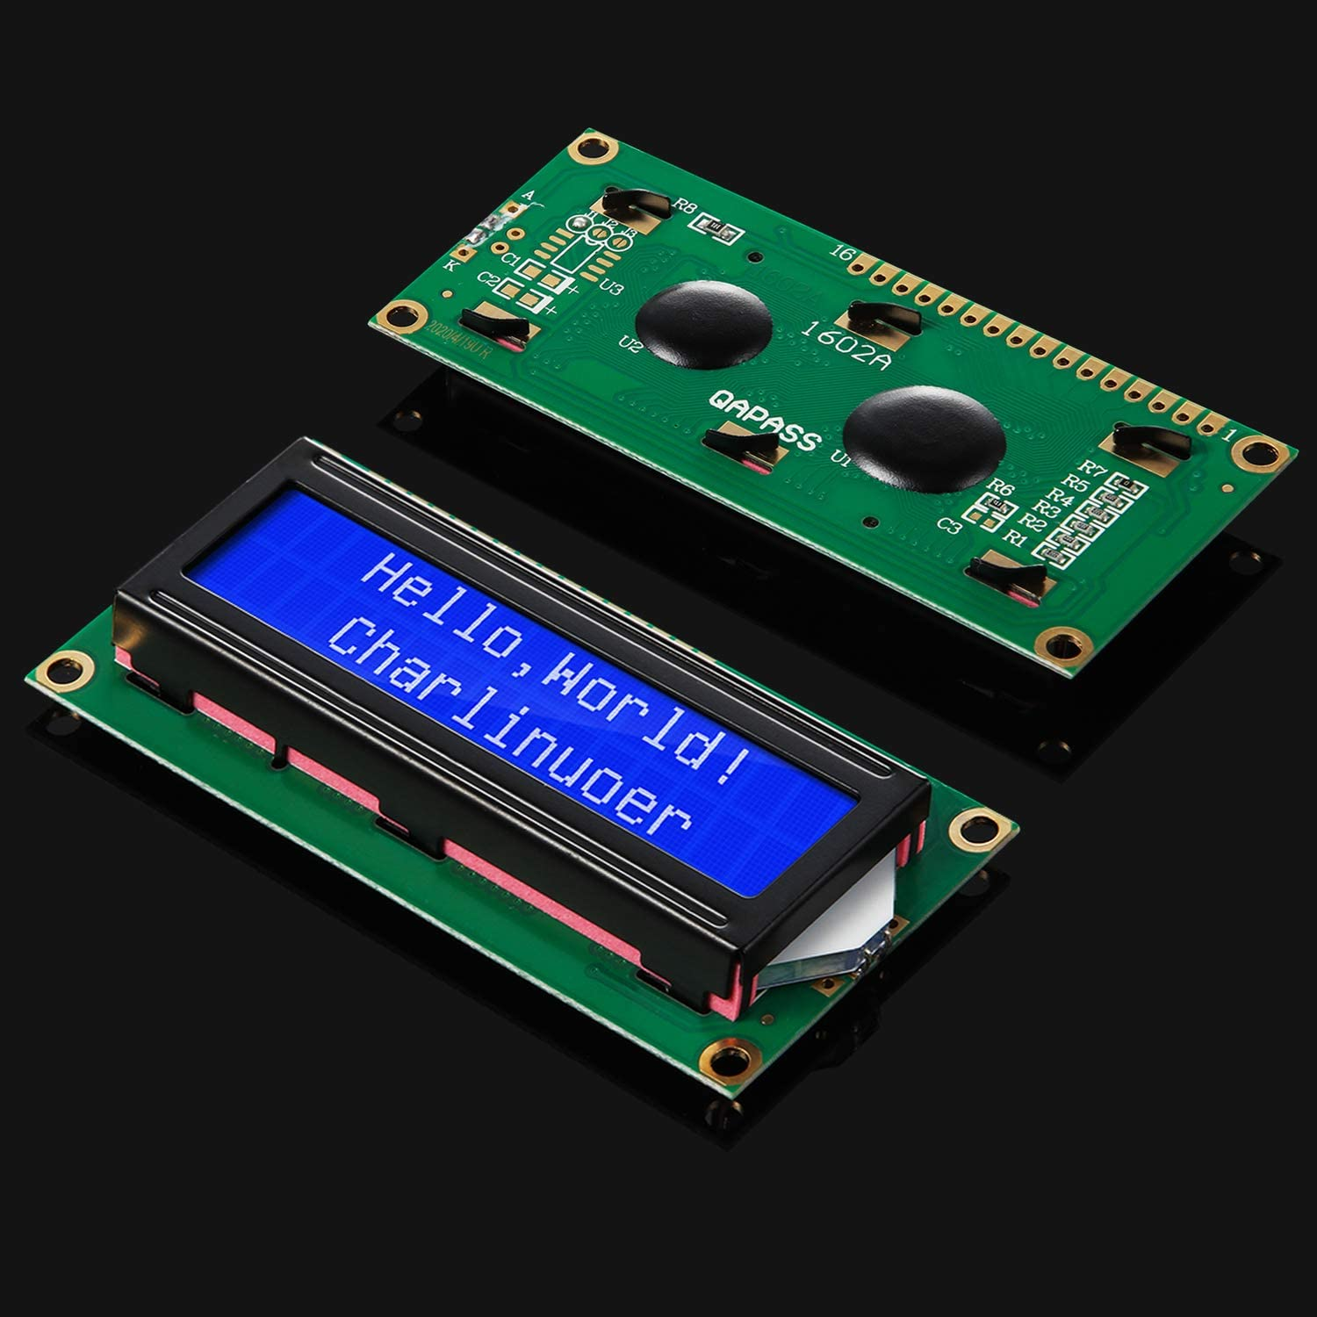
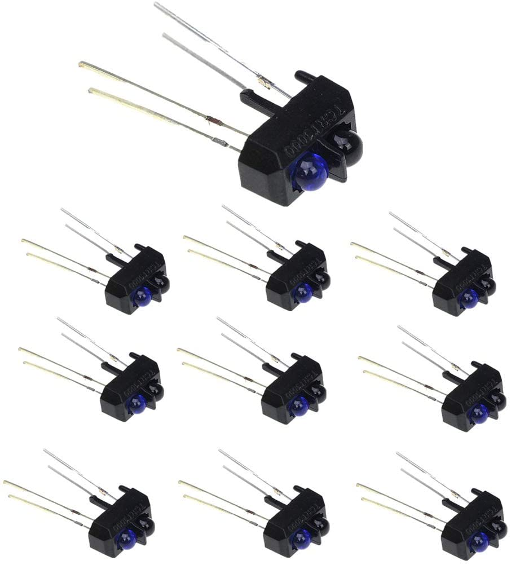
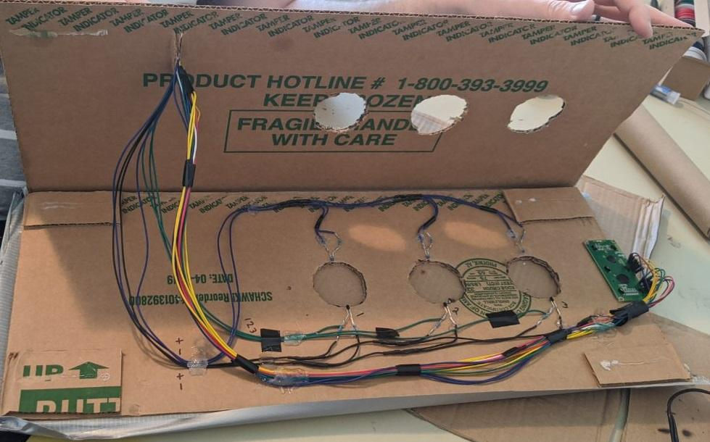
Hardware

Slide 4
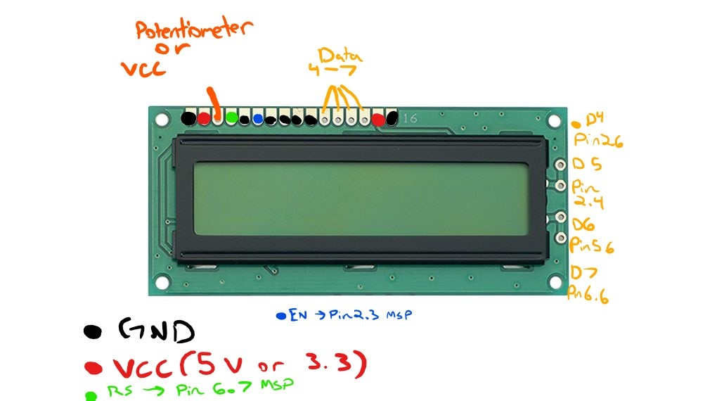
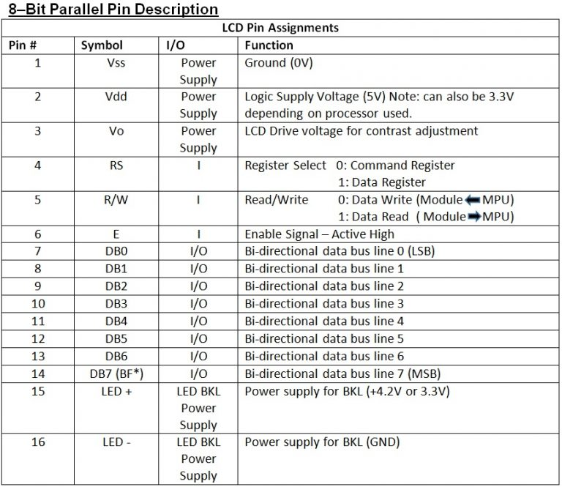
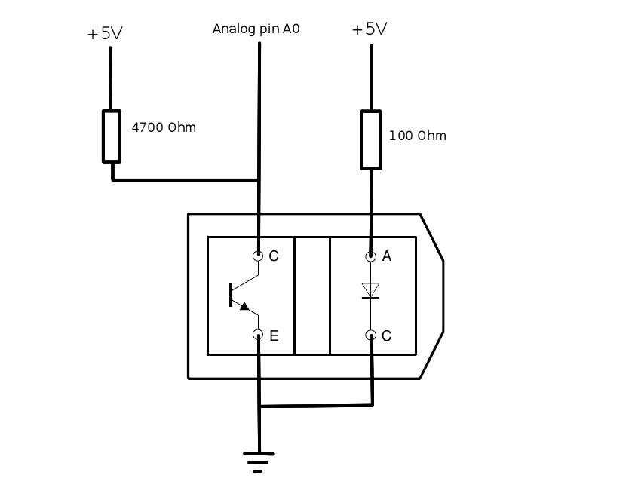
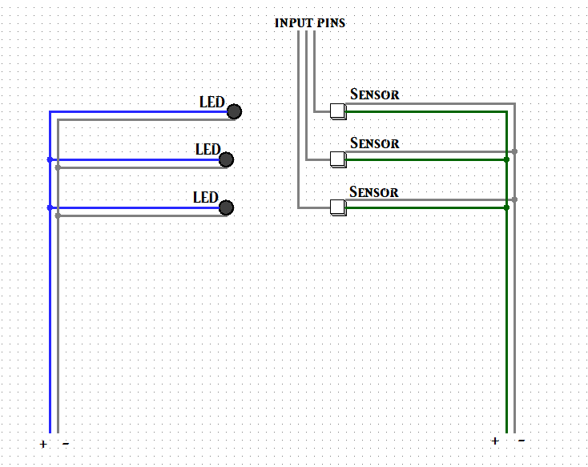
Diagrams

Slide 5
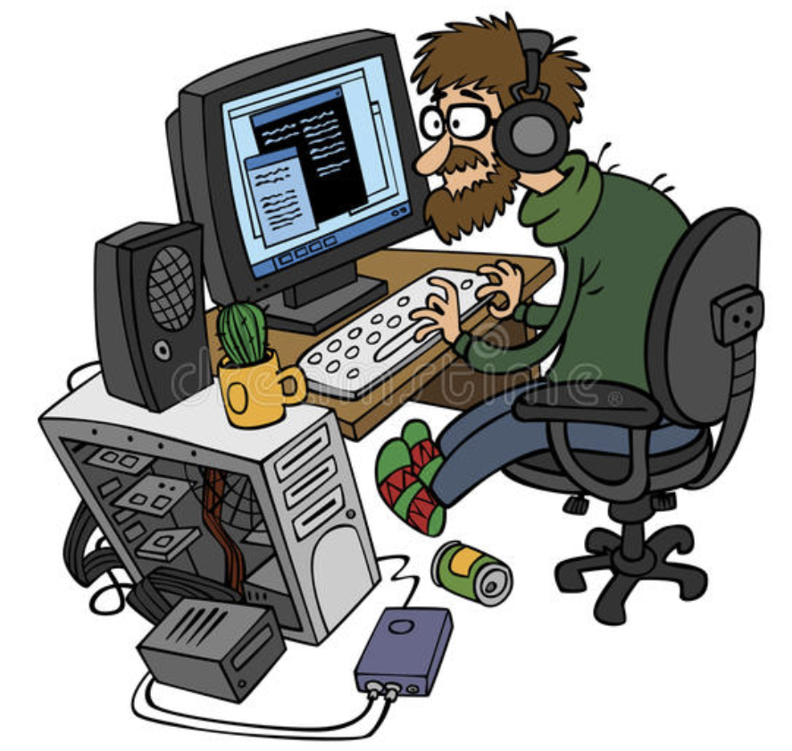
Some bumps we hit along the way
Remote/ virtual coordination and testing
Combining our C code with Energia code
Finding proper documentation for the sensors
Increasing the range of the sensors
Adjusting code for a different LCD
Implementing a timer (using delays rather then onboard clock)

Slide 6
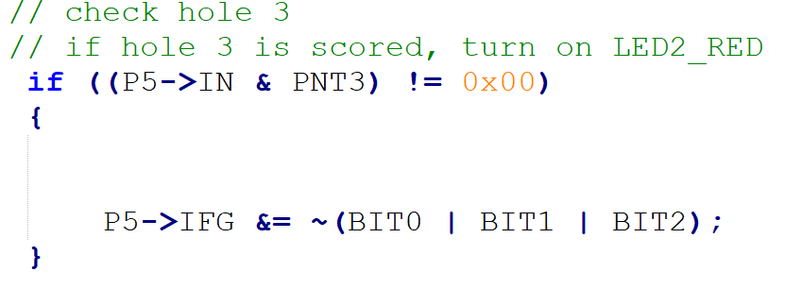
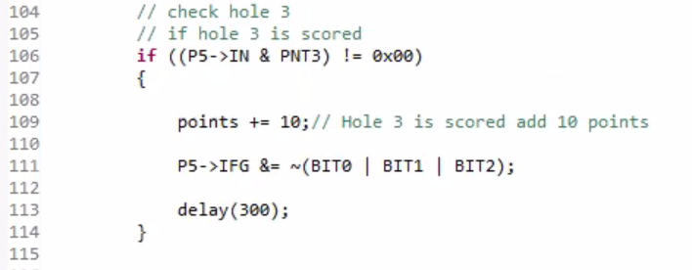
Things we learned and problems we came across
Timing systems (different methods. Ie onboard clk, delays)
Different interrupt implementation for C/ Arduino code
Soldering
Adapting arduino code.
Interfacing with different LCDs
Interrupts with C
Interrupts with Arduino

Slide 7
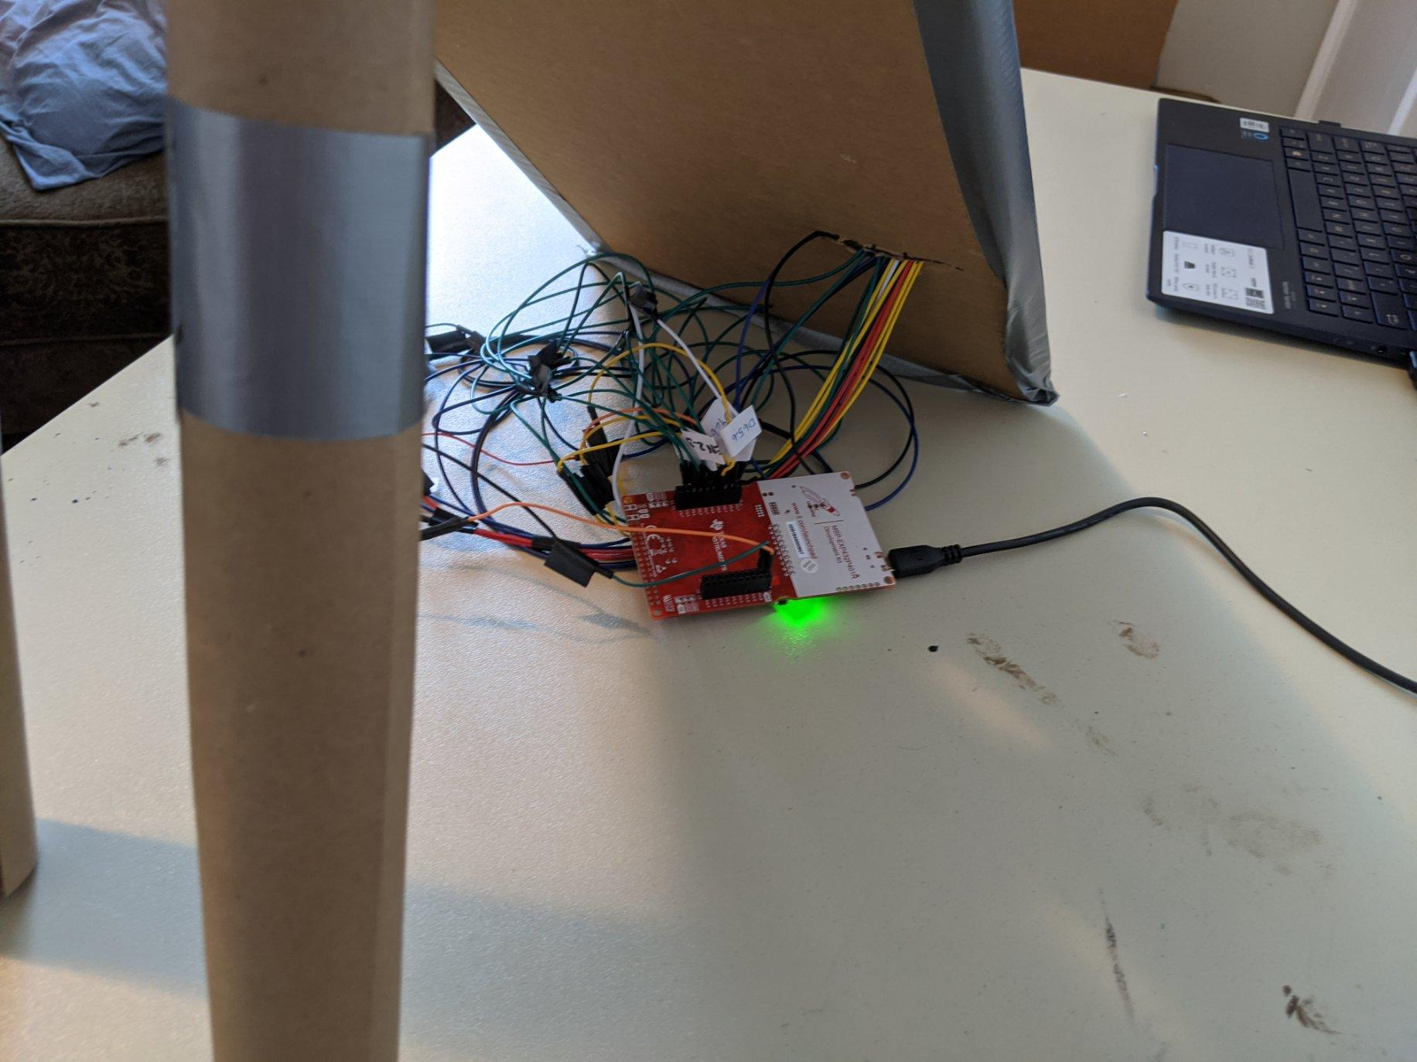
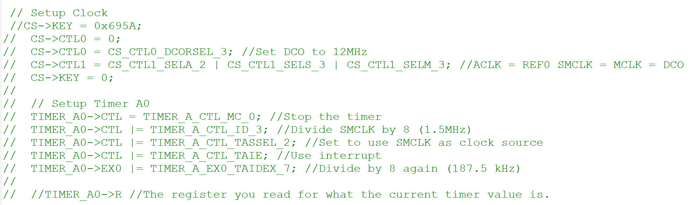
What could be improved for the project
Implement a timer( off the onboard clock - 10kHz- 48MHz )
Battery system ( 1.7V- 3.7V)
Full sized game ready board (Bigger holes, stronger sensors, wooden board)
Reset Switch on the game board
Cable management solution
Potentiometer to control Display contrast
Timer implementation with onboard clock

Slide 8
Resourses
https://e2e.ti.com/support/microcontrollers/msp430/f/166/t/601275?MSP432P401R-Powering-the-MSP432-Externally
https://www.arduinolibraries.info/libraries/liquid-crystal
https://components101.com/microcontrollers/msp432-launchpad
https://training.ti.com/msp432-mcus-clock-system-and-memory
Google images

Slide 9
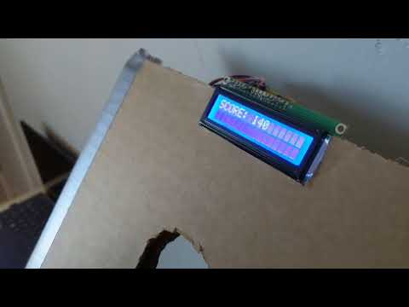
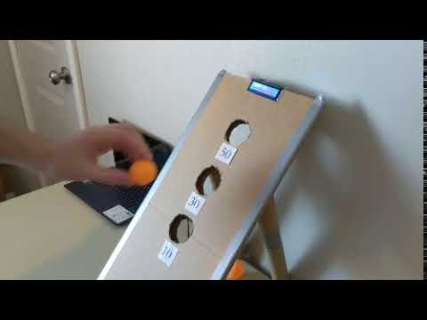
End Result
-Google Images

